Slide 1
CS 355/555
Probability and Statistics for CS
Baocheng Geng
Lecture 6 01/26/2023
CS 355/555 Probability and Statistics for CS

Slide 2







Introduction
Introduction
Independence
Combining Independent Events
Reliability pg 40
Conditional Independence
A^{C} and B^{C} Independent?
Next Time
CS 355/555 Probability and Statistics for CS

Slide 3
Copyright Statement
Copyright Statement
Materials prepared for and/or included in this course are protected by copyright law. They are intended to be used only by students enrolled in this course during the current term and should not be further disseminated without prior permission from the course instructor.
CS 355/555 Probability and Statistics for CS

Slide 4
Independence
Independence
Two events, A and B are independent if P (A|B) = P (A)
CS 355/555 Probability and Statistics for CS

Slide 5
Independence
P (A ∩ B)
Remember P (A|B) =
P (B)
CS 355/555 Probability and Statistics for CS
7/19 10:14

Slide 6
Independence
P (A ∩ B)
Remember P (A|B) =
P (B)
So, if A and B are independent
P (A ∩ B)
P (A) = P (A|B) =
P (B)
Therefore
P (A ∩ B) = P (A)P (B)
CS 355/555 Probability and Statistics for CS
7/19 10:14

Slide 7
Independence
P (A ∩ B)
Remember P (A|B) =
P (B)
So, if A and B are independent
P (A ∩ B)
P (A) = P (A|B) =
P (B)
Therefore
P (A ∩ B) = P (A)P (B)
And also
P (A ∩ B)
P (B ∩ A)
P (B) =
=
= P (B|A)
P (A)
P (A)
CS 355/555 Probability and Statistics for CS
7/19 10:14

Slide 8
Determine Independence by Table
There are two programming groups, Group C and Group N.
If they both work on a task, the probability of both succeeding is 5/12.
P(C success and N failure) = 1/4. P(C fail and N succeed) = 1/12 P(both fail) = 1/4
CS 355/555 Probability and Statistics for CS
8/19 10:14

Slide 9
Determine Independence by Table
There are two programming groups, Group C and Group N.
If they both work on a task, the probability of both succeeding is 5/12.
P(C success and N failure) = 1/4. P(C fail and N succeed) = 1/12 P(both fail) = 1/4
Do the groups succeed or fail independently?
CS 355/555 Probability and Statistics for CS
8/19 10:14

Slide 10
Determine Independence by Table
 | CS | CF
NS | 5 12 | 1 12
NF | 1 4 | 1 4
CS 355/555 Probability and Statistics for CS

Slide 11
Determine Independence by Table
 | CS | CF
NS | 5 12 | 1 12 | 1 2
NF | 1 4 | 1 4 | 1 2
 | 2 3 | 1 3
CS 355/555 Probability and Statistics for CS

Slide 12
Determine Independence by Table
Remembering P (A ∩ B) = P (A) × P (B), what would each table entry be if A and B are independent?
 | CS | CF
NS | 1 3 | 1 6 | 1 2
NF | 1 3 | 1 6 | 1 2
 | 2 3 | 1 3
 | CS | CF
NS | 5 12 | 1 12 | 1 2
NF | 1 4 | 1 4 | 1 2
 | 2 3 | 1 3
CS 355/555 Probability and Statistics for CS
11/19 10:14

Slide 13
Determine Independence by Table
Remembering P (A ∩ B) = P (A) × P (B), what would each table entry be if A and B are independent?
 | CS | CF
NS | 1 3 | 1 6 | 1 2
NF | 1 3 | 1 6 | 1 2
 | 2 3 | 1 3
 | CS | CF
NS | 5 12 | 1 12 | 1 2
NF | 1 4 | 1 4 | 1 2
 | 2 3 | 1 3
Not independent.
CS 355/555 Probability and Statistics for CS
11/19 10:14

Slide 14
Combining Independent Events
Suppose A, B independent.
P (A&B) = P (A ∩ B) = P (A) × P (B)
P (at least one ) = 1 − (1 − P ((A)) × (1 − P (B))
CS 355/555 Probability and Statistics for CS

Slide 15
At Least One
 | (1 − P (A)) (×(1 − P (B))
P (A) · P (B)
P (A)
P (B)
P (at least one ) = 1 − (1 − P ((A)) × (1 − P (B))
CS 355/555 Probability and Statistics for CS

Slide 16
Reliability
A software package is updated regularly. There are two quality control teams who look for problems with the software independently. Team A finds ³ of the problems and Team B finds ⁵ of the problems.
4 8
What is the probability that they will both find a problem?
CS 355/555 Probability and Statistics for CS
14/19 10:14

Slide 17
Reliability
A software package is updated regularly. There are two quality control teams who look for problems with the software independently. Team A finds ³ of the problems and Team B finds ⁵ of the problems.
4 8
What is the probability that they will both find a problem?
3 5 15
× =
4 8 32
CS 355/555 Probability and Statistics for CS
14/19 10:14

Slide 18
Reliability
A software package is updated regularly. There are two quality control teams who look for problems with the software independently. Team A finds ³ of the problems and Team B finds ⁵ of the problems.
4 8
What is the probability that they will both find a problem?
3 5 15
× =
4 8 32
What is the probability that at least one of them will find a problem?
CS 355/555 Probability and Statistics for CS
14/19 10:14

Slide 19
Reliability
A software package is updated regularly. There are two quality control teams who look for problems with the software independently. Team A finds ³ of the problems and Team B finds ⁵ of the problems.
4 8
What is the probability that they will both find a problem?
3 5 15
× =
4 8 32
What is the probability that at least one of them will find a problem?
3 5 1 3 29
1 − 1 − × 1 − = 1 − × =
( ) ( )
4
8 4 8 32
CS 355/555 Probability and Statistics for CS
14/19 10:14

Slide 20
At Least One
5 | 5 | 15
8 | 32 | 32
3 | 3 | 9
8 | 32 | 32
 | 1 | 3
 | 4 | 4
CS 355/555 Probability and Statistics for CS

Slide 21
Independent Events Example
Toss a fair die:
A = {1,2 ,3} B={3,4,5}

Slide 22
Conditional Independence
Conditional Independence
Two events, A and B, are conditionally independent if for event C
P (A ∩ B|C) = P (A|C) × P (B|C)
CS 355/555 Probability and Statistics for CS

Slide 23
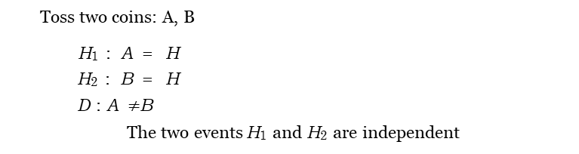
Example 1.20 pg 37
Toss two coins: A, B
H₁ : A = H H₂ : B = H D : A $≠$B
The two events H₁ and H₂ are independent
CS 355/555 Probability and Statistics for CS

Slide 24
Example 1.20 pg 37
Toss two coins: A, B
H₁ : A = H H₂ : B = H D : A $≠$B
The two events H₁ and H₂ are independent
1
P (H₁|D) = ₂
P (H₂|D) = ₂
P (H₁ ∩ H₂) = ₄
P ((H₁ ∩ H₂)|D) = 0
1
1
So, H₁ and H₁ are not conditionally independent.
CS 355/555 Probability and Statistics for CS

Slide 25
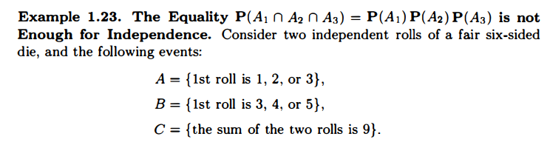
Example 1.23 pg 39
CS 355/555 Probability and Statistics for CS

Slide 26
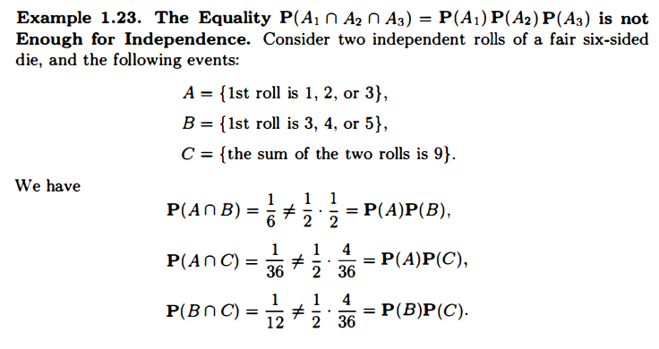
Example 1.23 pg 39
CS 355/555 Probability and Statistics for CS

Slide 27
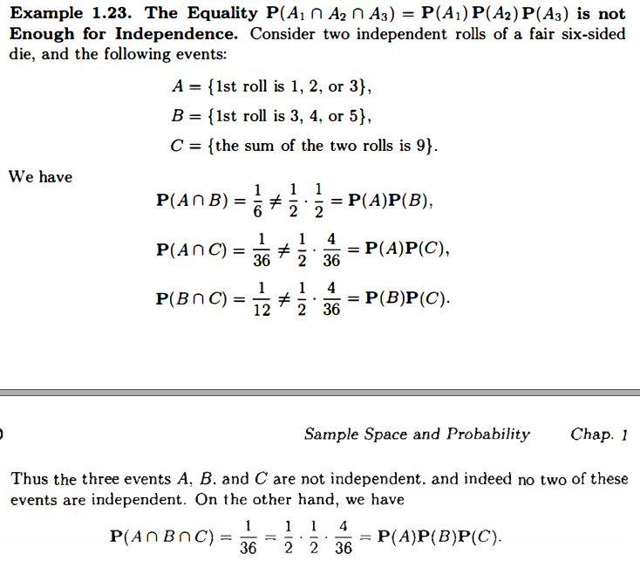
Example 1.23 pg 39
CS 355/555 Probability and Statistics for CS

Slide 28
A and B independent ⇒ A^{C} and B^{C} independent
Suppose A and B are independent events. Then
1 = P (A&B) + P (A)P (B^{C} ) + P (A^{C} )P (B) + P (A^{C} &B^{C} )
CS 355/555 Probability and Statistics for CS
18/19 10:14

Slide 29
A and B independent ⇒ A^{C} and B^{C} independent
Suppose A and B are independent events. Then
1 = P (A&B) + P (A)P (B^{C} ) + P (A^{C} )P (B) + P (A^{C} &B^{C} )
1 = P (A)P (B) + P (A)P (B^{C} ) + P (A^{C} )P (B) + P (A^{C} &B^{C} )
CS 355/555 Probability and Statistics for CS
18/19 10:14

Slide 30
A and B independent ⇒ A^{C} and B^{C} independent
Suppose A and B are independent events. Then
1 = P (A&B) + P (A)P (B^{C} ) + P (A^{C} )P (B) + P (A^{C} &B^{C} )
1 = P (A)P (B) + P (A)P (B^{C} ) + P (A^{C} )P (B) + P (A^{C} &B^{C} )
1 = P (A)P (B) + P (A)(1 − P (B)) + (1 − P (A))P (B) + P (A^{C} &B^{C} )
CS 355/555 Probability and Statistics for CS
18/19 10:14

Slide 31
A and B independent ⇒ A^{C} and B^{C} independent
Suppose A and B are independent events. Then
1 = P (A&B) + P (A)P (B^{C} ) + P (A^{C} )P (B) + P (A^{C} &B^{C} )
1 = P (A)P (B) + P (A)P (B^{C} ) + P (A^{C} )P (B) + P (A^{C} &B^{C} )
1 = P (A)P (B) + P (A)(1 − P (B)) + (1 − P (A))P (B) + P (A^{C} &B^{C} )
1 =
P (A)P (B) + P (A) − P (A)P (B) − P (A)P (B) + P (B) + P (A^{C} &B^{C} )
CS 355/555 Probability and Statistics for CS
18/19 10:14

Slide 32
A and B independent ⇒ A^{C} and B^{C} independent
Suppose A and B are independent events. Then
1 = P (A&B) + P (A)P (B^{C} ) + P (A^{C} )P (B) + P (A^{C} &B^{C} )
1 = P (A)P (B) + P (A)P (B^{C} ) + P (A^{C} )P (B) + P (A^{C} &B^{C} )
1 = P (A)P (B) + P (A)(1 − P (B)) + (1 − P (A))P (B) + P (A^{C} &B^{C} )
1 =
P (A)P (B) + P (A) − P (A)P (B) − P (A)P (B) + P (B) + P (A^{C} &B^{C} )
1 = P (A) − P (A)P (B) + P (B) + P (A^{C} &B^{C} )
CS 355/555 Probability and Statistics for CS
18/19 10:14

Slide 33
A and B independent ⇒ A^{C} and B^{C} independent
Suppose A and B are independent events. Then
1 = P (A&B) + P (A)P (B^{C} ) + P (A^{C} )P (B) + P (A^{C} &B^{C} )
1 = P (A)P (B) + P (A)P (B^{C} ) + P (A^{C} )P (B) + P (A^{C} &B^{C} )
1 = P (A)P (B) + P (A)(1 − P (B)) + (1 − P (A))P (B) + P (A^{C} &B^{C} )
1 =
P (A)P (B) + P (A) − P (A)P (B) − P (A)P (B) + P (B) + P (A^{C} &B^{C} )
1 = P (A) − P (A)P (B) + P (B) + P (A^{C} &B^{C} )
P (A^{C} &B^{C} ) = 1 − P (A) + P (A)P (B) − P (B)
CS 355/555 Probability and Statistics for CS
18/19 10:14

Slide 34
A and B independent ⇒ A^{C} and B^{C} independent
Suppose A and B are independent events. Then
1 = P (A&B) + P (A)P (B^{C} ) + P (A^{C} )P (B) + P (A^{C} &B^{C} )
1 = P (A)P (B) + P (A)P (B^{C} ) + P (A^{C} )P (B) + P (A^{C} &B^{C} )
1 = P (A)P (B) + P (A)(1 − P (B)) + (1 − P (A))P (B) + P (A^{C} &B^{C} )
1 =
P (A)P (B) + P (A) − P (A)P (B) − P (A)P (B) + P (B) + P (A^{C} &B^{C} )
1 = P (A) − P (A)P (B) + P (B) + P (A^{C} &B^{C} )
P (A^{C} &B^{C} ) = 1 − P (A) + P (A)P (B) − P (B)
P (A^{C} &B^{C} ) = P (A^{C} ) − P (B)(1 − P (A))
CS 355/555 Probability and Statistics for CS
18/19 10:14

Slide 35
A and B independent ⇒ A^{C} and B^{C} independent
Suppose A and B are independent events. Then
1 = P (A&B) + P (A)P (B^{C} ) + P (A^{C} )P (B) + P (A^{C} &B^{C} )
1 = P (A)P (B) + P (A)P (B^{C} ) + P (A^{C} )P (B) + P (A^{C} &B^{C} )
1 = P (A)P (B) + P (A)(1 − P (B)) + (1 − P (A))P (B) + P (A^{C} &B^{C} )
1 =
P (A)P (B) + P (A) − P (A)P (B) − P (A)P (B) + P (B) + P (A^{C} &B^{C} )
1 = P (A) − P (A)P (B) + P (B) + P (A^{C} &B^{C} )
P (A^{C} &B^{C} ) = 1 − P (A) + P (A)P (B) − P (B)
P (A^{C} &B^{C} ) = P (A^{C} ) − P (B)(1 − P (A))
P (A^{C} &B^{C} ) = P (A^{C} ) − P (B)P (A^{C} )
CS 355/555 Probability and Statistics for CS
18/19 10:14

Slide 36
A and B independent ⇒ A^{C} and B^{C} independent
Suppose A and B are independent events. Then
1 = P (A&B) + P (A)P (B^{C} ) + P (A^{C} )P (B) + P (A^{C} &B^{C} )
1 = P (A)P (B) + P (A)P (B^{C} ) + P (A^{C} )P (B) + P (A^{C} &B^{C} )
1 = P (A)P (B) + P (A)(1 − P (B)) + (1 − P (A))P (B) + P (A^{C} &B^{C} )
1 =
P (A)P (B) + P (A) − P (A)P (B) − P (A)P (B) + P (B) + P (A^{C} &B^{C} )
1 = P (A) − P (A)P (B) + P (B) + P (A^{C} &B^{C} )
P (A^{C} &B^{C} ) = 1 − P (A) + P (A)P (B) − P (B)
P (A^{C} &B^{C} ) = P (A^{C} ) − P (B)(1 − P (A))
P (A^{C} &B^{C} ) = P (A^{C} ) − P (B)P (A^{C} )
P (A^{C} &B^{C} ) = P (A^{C} )(1 − P (B))
CS 355/555 Probability and Statistics for CS
18/19 10:14

Slide 37
A and B independent ⇒ A^{C} and B^{C} independent
Suppose A and B are independent events. Then
1 = P (A&B) + P (A)P (B^{C} ) + P (A^{C} )P (B) + P (A^{C} &B^{C} )
1 = P (A)P (B) + P (A)P (B^{C} ) + P (A^{C} )P (B) + P (A^{C} &B^{C} )
1 = P (A)P (B) + P (A)(1 − P (B)) + (1 − P (A))P (B) + P (A^{C} &B^{C} )
1 =
P (A)P (B) + P (A) − P (A)P (B) − P (A)P (B) + P (B) + P (A^{C} &B^{C} )
1 = P (A) − P (A)P (B) + P (B) + P (A^{C} &B^{C} )
P (A^{C} &B^{C} ) = 1 − P (A) + P (A)P (B) − P (B)
P (A^{C} &B^{C} ) = P (A^{C} ) − P (B)(1 − P (A))
P (A^{C} &B^{C} ) = P (A^{C} ) − P (B)P (A^{C} )
P (A^{C} &B^{C} ) = P (A^{C} )(1 − P (B))
P (A^{C} &B^{C} ) = P (A^{C} )P (B^{C} )
Then A^{C} and B^{C} are independent events.
CS 355/555 Probability and Statistics for CS
18/19 10:14

Slide 38
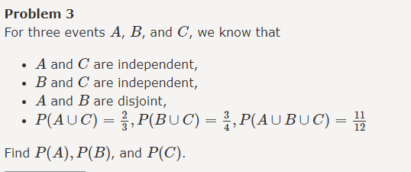
Finding Probabilities
Hint: Venn Diagram

Slide 39
Next Class
Task: read reliability problem in pg 40
Read Chapter 1, 1.5 ppg 34 - 43 (Again)
CS 355/555 Probability and Statistics for CS
19/19 10:14

